Slide 1

Department of Artificial Intelligence and Data Science
Advancing Dermatology with Deep Learning:An ensemble Model for Skin Lesion Classification
Batch No : 04
Academic Year : 2023-2024
20L31A5452 – RACHAKONDA SIVA SAI ABHISHEK
20L31A5435 –CHANDRA KARTHIK
20L31A5430 – RITESH
20L31A5453 – SAKETI PAVAN KUMAR
20L31A5417 –DVS SWAROOP
Project Guide
Mr. D.Chandra Mouli
Asst. Prof

Slide 2
INDEX
ResNet Model
ResNet Architecture
Model Training
Accuracy and Loss
Testing &Results

Slide 3
ResNet Model
The ResNet-101 architecture is a powerful convolutional neural network (CNN) that has been widely used for image classification tasks.
ResNet stands for Residual Network. It addresses the problem of degradation in deep networks. As networks get deeper, accuracy tends to saturate and then degrade rapidly.
To overcome this, Microsoft introduced a residual learning framework. Instead of expecting each layer to directly fit a desired underlying mapping, ResNet explicitly lets layers fit a residual mapping.
Shortcut connections (skip connections) perform identity mapping, and their outputs are added to the outputs of stacked layers connections perform identity mapping, and their outputs are added to the outputs of stacked layers.

Slide 4
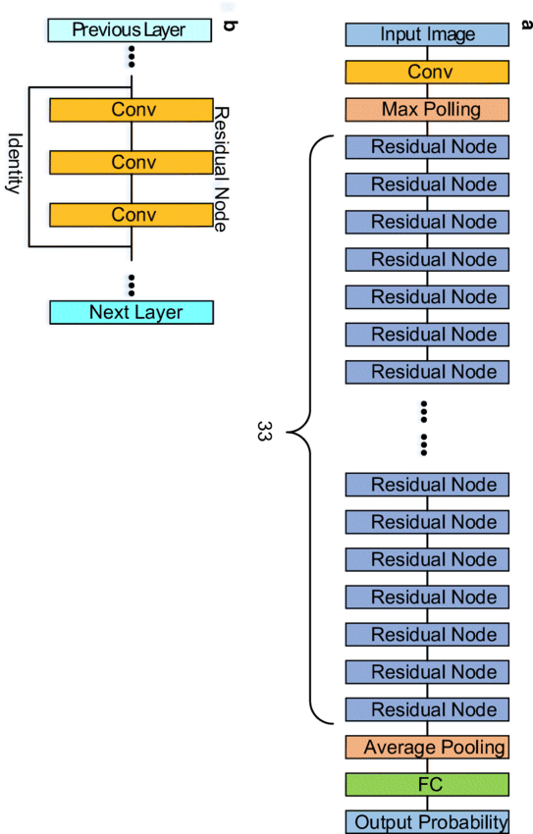
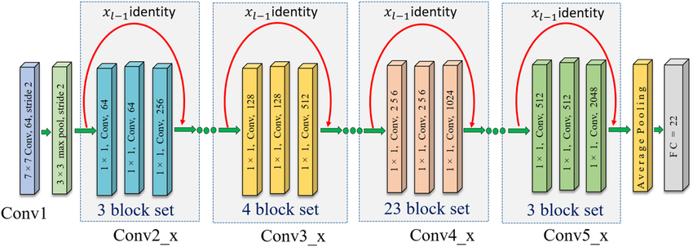
Res-Net 101 ARCHITECTURE

Slide 5
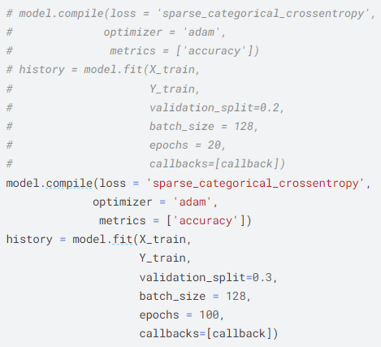
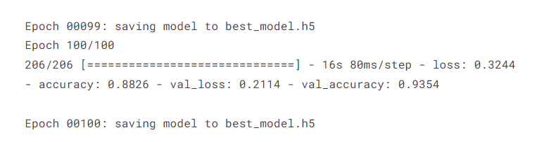
MODEL TRAINING
Training the Model: Utilizing 'sparse_categorical_crossentropy' loss and 'adam' optimizer for improved accuracy. Training on X_train and Y_train with a validation split of 0.3, batch size of 128, and 100 epochs, incorporating callback for enhanced performance.
Training Progress: Epoch 100/100 - Loss: 0.3244, Accuracy: 88.26% - Validation Loss: 0.2114, Validation Accuracy: 93.54%. Model checkpoints saved to 'best_model.h5' after each epoch for best performance tracking.

Slide 6
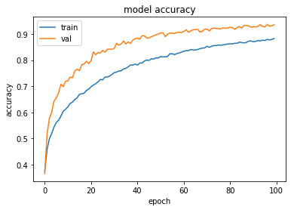
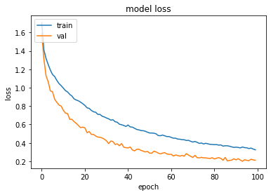
Accuracy and Loss

Slide 7
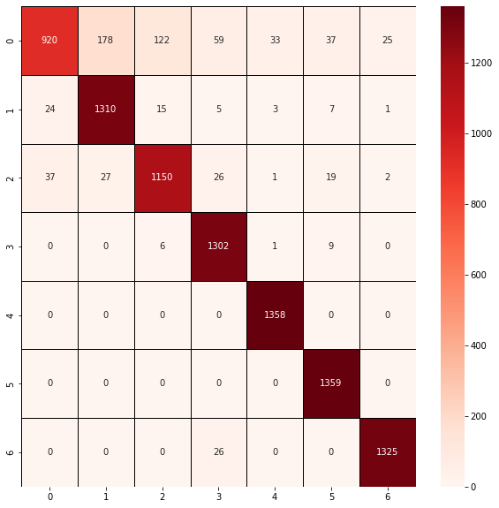
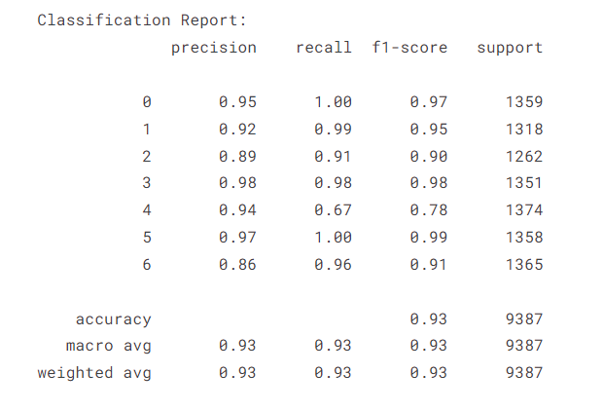
Evaluation Metrics

Slide 8
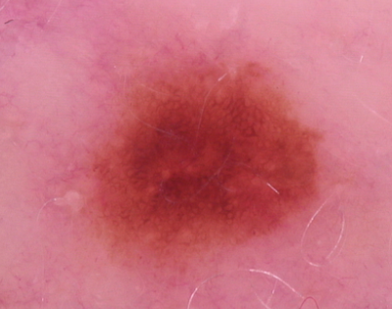
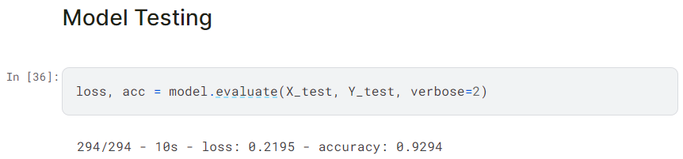

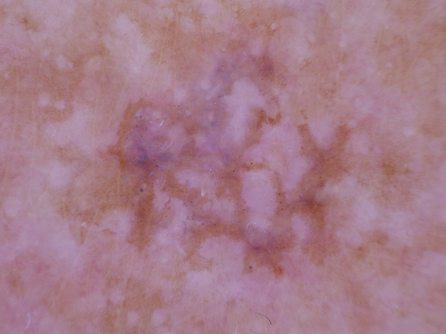
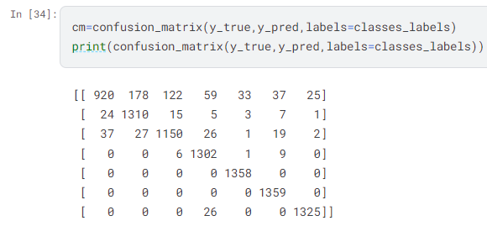
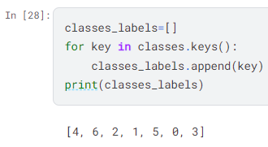
Testing & Results

